Slide 1
Coping with stress
Managing and coping with stress: drug therapy (benzodiazepines, beta blockers), stress inoculation therapy and biofeedback.
Gender differences in coping with stress. The role of social support in coping with stress; types of social support, including instrumental, emotional and esteem support.

Slide 2
Syllabus
Managing and coping with stress:
Drug therapy (benzodiazepines, beta blockers), stress inoculation therapy and biofeedback.

Slide 3
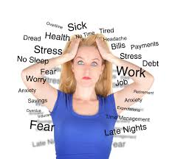
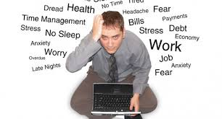

Slide 4
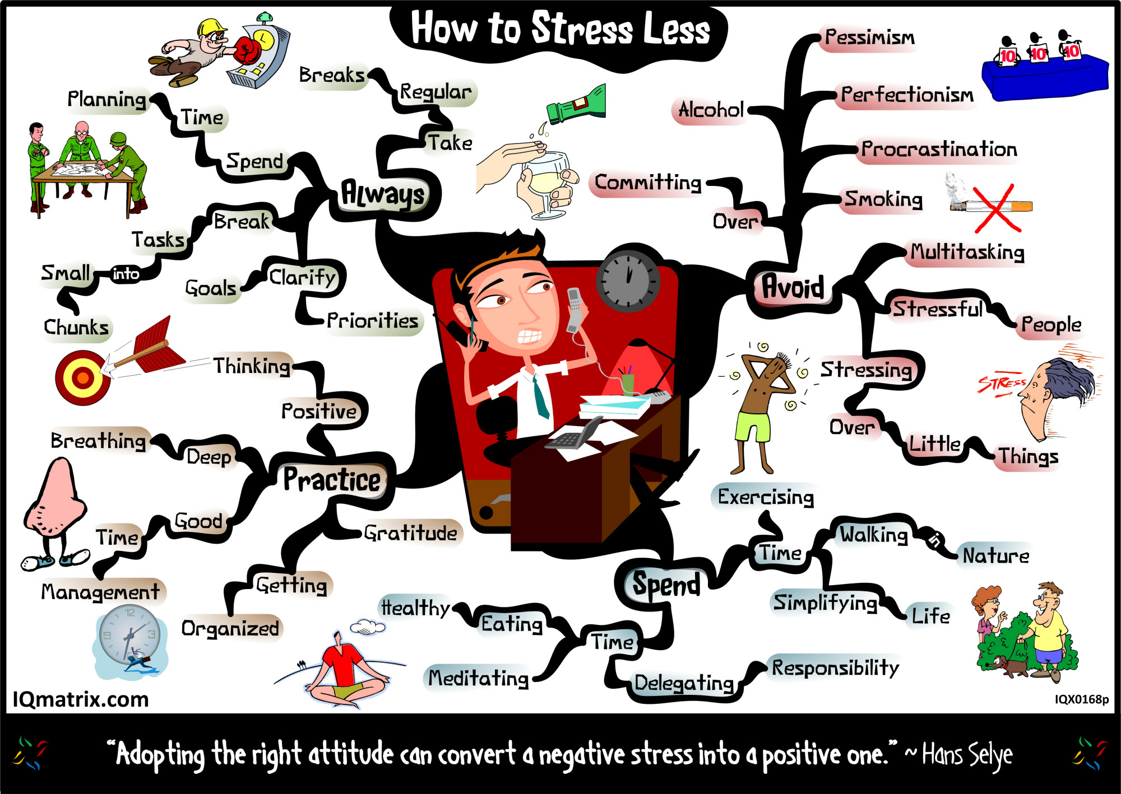

Slide 5
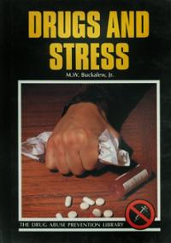
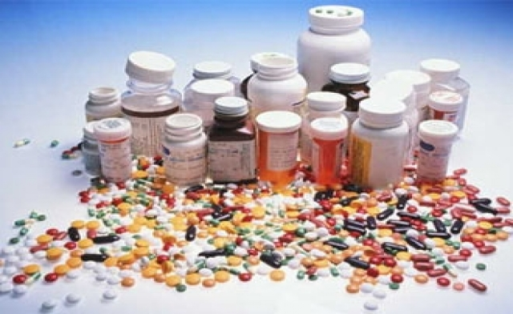
Drugs

Slide 6
Physiological Methods
PHYSIOLOGICAL METHODS OF STRESS MANAGEMENT Techniques that aim to reduce stress by altering the body’s natural stress responses.
1. DRUGS
What are they? Anxiolytic drugs reduce anxiety. These include:
• Benzodiazepines: e.g. valium. These act on synapses and neurotransmitters, promoting natural biochemical substance called GABA = the body’s natural form of anxiety relief.
  GABA reduces serotonin levels , decreases arousal of neurons ‡ reduced anxiety.
  GABA slows down nerve cell activity, allowing chloride ions into neurons, slowing activity and causing relaxation. Side effects = sleepiness and dependence
All drugs are related to the bodily processes involved in the stress response, i.e. they intervene in the activity of the ANS.
Evaluation
Easy to use Effective Available Short term Only tackle symptoms not the real problem Unpleasant side effects – upset stomach, drowsiness, blurred vision, irregular heart beat Dependency – limit of 4 weeks.
Good?

Slide 7

Beta Blockers
Beta-blockers aim to reduce the activity of adrenaline and noradrenaline (the two hormones which bring about these physiological changes caused by stress).

Slide 8
How do Beta-blockers work?
Reduce the activity of adrenaline and noradrenaline.
Beta-blocked bind to receptors on the cells of the heart and other parts of the body that are usually stimulated during arousal. By blocking these receptors, it is harder to stimulate cells (for example, in the heart) as a result, the heart beats slower and with less force.
This results in;
Fall in blood pressure (so there is less pressure on the heart)
The person feeling calmer and less anxious.

Slide 9
Evaluation +
Point: Research has demonstrated that drug treatments are extremely effective in treating the negative effects of stress.
Evidence: For example, Kahn et al (1986) compared placebos and anti-anxiety drugs in 250 patients. The experimental group of patients were given an anxiety drug and however the control group of patients were given a placebo. Kahn et al found that BZs were significantly superior to placebos in treating the symptoms of anxiety which has been caused by stress.
Evaluation: This is a strength as physiological/biological treatments of stress (e.g. drugs) can be seen to be just as effective as psychological treatments (e.g. CBT).

Slide 10
Evaluation -
Point: Drug treatments of stress have been criticised for having a number of negative side effects.
Evidence: For example, patients taking medication for stress (e.g. Beta-blockers and anti-anxiety drugs) have reported many side effects including; drowsiness, dizziness, tiredness, dry mouth, diarrhoea, loss of appetite.
Evaluation: This is a weakness as it could cause more harm than good and other treatments (e.g. psychological treatments such as CBT) may be more effective at elevating the negative symptoms of stress.

Slide 11
Evaluation -
Point: Drug treatments of stress can be criticised for treating the symptoms and not the cause of the stressor.
Evidence: For example, drug treatments such as anti-anxieties and Beta-blockers will only remove the negative symptoms associated with stress (e.g. increased heart rate, blood pressure) they will not help the individual deal effectively to remove the stressor.
Evaluation: This is a problem because in the cases of chronic stress it may not be appropriate to simply manage the symptoms and so it may be preferable to seek a treatment that addresses the problem itself (e.g. CBT).

Slide 12
COPE scale
Carver et al: 15 coping strategies .
Questionnaire used to assess an individuals coping strategies. It provides ratings on 15 different strategies.
Hand out showing cope scale - discuss

Slide 13
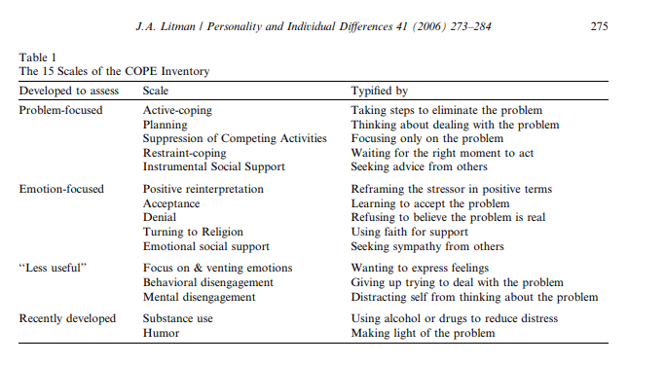

Slide 14
Syllabus
Gender differences in coping with stress. The role of social support in coping with stress; types of social support, including instrumental, emotional and esteem support.

Slide 15
Gender differences
One of the criticisms of the research into the acute stress response (the SAM pathway) is that it was derived from studies using male participants. Males are preferred because their hormone levels do not alter due to an ovulation cycle. Subsequent research with female participants has shown that there are significant gender differences in coping with stress.

Slide 16
Physiological (Biological) Explanations of Gender Differences:
Taylor et al (2000) first proposed the notion of the tend-and-befriend response to stress suggesting that this would have evolved as a typical response in females in situations of threat.
She argued that the fight or flight response would be displayed by both genders but, for females, there would be a greater adaptive advantage to produce a tend-and-befriend response, and thus this is the most common stress response for females.
The reason the tend-and-befriend response is a more adaptive response for females due to differential parental investment – females invest more in each single reproduction than males. Therefore, female stress responses have evolved to maximise the survival of their offspring.
Both males and females experience the same physiological response to stress (producing adrenaline, noradrenaline and cortisol).
Alongside the production of these hormones, another hormone (oxytocin) is produced in both males and females. Oxytocin (often referred to as the ‘love’ hormone) promotes feelings of bonding and general social-ness.
In males, testosterone levels also rise (which has a dampening effect on oxytocin), therefore, males become more aggressive (due to testosterone) and females seek closeness to others (because of unrepressed oxytocin). This response would be at its strongest in women who are breastfeeding because oxytocin is produced at this time.

Slide 17
Peterson et al (2006)
Procedure: Just over 1,000 men and women seeking fertility treatment at a hospital were recruited for a study on coping styles and asked to complete several questionnaires, including the Ways of Coping Questionnaire (designed by Lazarus and Folkman).
Findings:
Found clear gender differences.
Women used confrontive coping (a style where they try to alter the situation to reduce the emotional impact (emotion-focused coping).
Women were also more likely to seek social support and avoidance when compared to men.
In contrast, men engaged in problem-solving and distanced themselves from the problem (a kind of problem focus).
There was some emotion-focused coping in men, indicating that gender differences in not clear cut.
Conclusion: Although to some extent it appears that females adopt a more emotion-focused stress management style and men adopt a more problem-focused stress management style. In the most part, it can be seen that the differences between psychological stress management in males and females is not clear cut.

Slide 18
Weaknesses:
Point: There is a lack of research support for difference between male and female coping focus.
Example: For example, the finding that men are more problem-focused and women more emotion-focused is not upheld by most research studies. Hamilton and Fagot (1988) assessed male and female first-year undergraduates over an 8-week period and found no gender differences in the type of ‘focus’ males and females adopt.
Evaluation: This is a weakness because there is a lack of reliability surrounding the findings into gender differences and stress.
Also Self report!

Slide 19
Approach Coping
Roth and Cohen
Coping with stress by tackling the situation directly (long term)

Slide 20
Avoidant
Roth and Cohen
Pretending it does not exist. (short term)

Slide 21
Question
3 (a) What is meant by a problem-focused approach to coping with stress?
3 (b) What is meant by an emotion-focused approach to coping with stress?

Slide 22
Problem focussed coping
Target the causes of stress (stressors) and deals with them in practical ways to reduce them. Eg: remove the Lizard.

Slide 23
Problem-focused approach
Problem-focused approach to coping with stress involves the person actively trying to do something that deals with the stress. This might involve taking control by getting as much information as they can, considering possible alternative strategies, improving their coping
resources etc.
1 mark for a basic statement and further 2 marks for elaboration. For example, problem focused coping is doing something active such as taking control (1 mark) by finding out as much information about the forthcoming exam as possible and then planning and implementing a revision strategy (2 further marks for elaboration).

Slide 24
Emotion focussed coping
Targets the emotional response to the stressor (stage 2) Strategies include denial, distraction (think of other things) and seeking support from friends.

Slide 25
Emotion focused coping
Emotion focused coping involves strategies that deal with the emotions linked with the stress, rather than the stress itself. These might include, denial, venting, wishful thinking etc.
1 mark for a basic statement and further 2 marks for elaboration. For example, emotion focused coping is dealing with the emotions created by the stressful event such as through denial (1 mark). The person might carry on as if nothing is wrong and there is no stressor (a
further mark for slight elaboration). Note: social support can be a problem-focused approach (discussing the problem with other
people can help put the problem into perspective and provide practical information). It can also be an emotion-focused approach (getting emotional support from friends). Both are creditworthy.

Slide 26
Which is better
Style of coping influenced by the type of stressor. Controllability and perhaps gender.

Slide 27
Tennen et al
Studied patients with chronic pain in a longitudinal study. Used a questionnaire.
  Strategies used simultaneously there is an interaction between the methods of coping
  An increase of pain when using problem focussed coping meant the next day and increase in emotion coping. I.e.: the success or failure of one method led to a decrease or increase of the other method.

Slide 28
Psychological methods of dealing with stress
Cognitive behavioural therapy
Hardiness training

Slide 29
Cognitive behavioural therapy
Alter irrational thoughts.
Stress Inoculation Training SIT
  Conceptualisation - helps identify the stressors.
  Skills training e.g.: relaxation techniques (Le mars)
  Reflect and adapt

Slide 30
Hardiness
Kobasa
Focus on the physiological symptoms of stress. Identify the stressors . Acquire new skills and strategies with therapist.
Reconstruction. Thinks about past stressful events and how they could have been dealt with better.
Get the client improve self-efficacy by taking on past perceived stressors.

Slide 31
Stress Inoculation therapy
Stress Inoculation therapy (SIT) involves three stages.
The first is conceptualization, where the client and therapist identify the source of the stress. This could include keeping a diary of when and where the stressful experiences occurred. During this stage the therapist might even challenge the client’s views.
The second stage allows the client to learn specific skills and to practice them with the therapist.
  Finally the client will try out these skills in the real world. At the same time Reflect and adapt

Slide 32
Question
Karen has been feeling extremely stressed for several months. She has recently been promoted at work and is worried that she is not able to do the job properly in spite of praise from her managers. She also finds it very difficult to say “no” when colleagues ask for assistance. Her health is suffering and she decides to try Cognitive Behavioural
Therapy (CBT) to help manage her stress.
Explain what is involved in Cognitive Behavioural Therapy (CBT) and how it could be used to help Karen.

Slide 33
CBT
CBT is an umbrella term that includes a range of different treatments, such as SIT and hardiness training. All these methods share the common aim which is to change irrational thoughts and cognitive biases. Candidates can refer to a specific method or to CBT in general, either way would be creditworthy. SIT uses conceptualisation and skills training.
CBT could help Karen because she has irrational thoughts (worried she is unable to do the job properly even though she receives praise). The therapist might challenge Karen and ask her for evidence of examples when she couldn’t do her job well. Karen might also practice saying “no” to her therapist so that she can later do so in the real world. Since her problems
appear to be due to her cognitions, CBT would be an appropriate treatment.
For 4-6 marks, there must be active engagement with the scenario (this is not the same as merely using the name ‘Karen’).

Slide 34
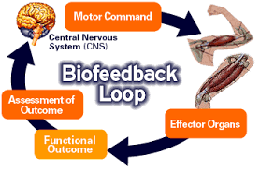

Slide 35
BIOFEEDBACK
2. What is it?
Techniques to learn voluntary control of involuntary behaviours by being made aware of ANS activity.
Learning occurs through:
A. Feedback
    a patient is connected to various monitoring devices to provide info about ANS activity e.g. light indicating high blood pressure.
  B. Relaxation
    a patient is taught methods of relaxation. Reduces activity of sympathetic nervous system and activating the parasympathetic nervous system.
  C. Operant conditioning
      certain behaviours are reinforced because they result in a desirable outcome.
Miller and DiCara Used 24 rats, keeping them alive through artificial respiration. Half were rewarded when their heart rate slowed down. Half were rewarded when their heart rate speeded up. Heart beats adapted to what they were rewarded by.
Evaluation
Effectiveness – Dworkin and Dworkin used biofeedback to teach sufferers of scoliosis to control their back muscles and alter their posture. No side effects Long lasting methods – future Non-invasive Expensive Time Consuming Treats the symptoms not the problem

Slide 36
Question
Long-term stress is often accompanied by psychological and physical changes.
Drug therapy is sometimes used to reduce these effects of stress.
Outline drug therapy as a method of stress management. 4 marks

Slide 37
Answer
The two main groups of drugs used to manage stress are Benzodiazepines and Beta-blockers. BZs act on the brain by increasing the action of GABA. This neurotransmitter reduces the activity of other neurotransmitters in the brain.
Beta-blockers act directly on the cardiovascular system. They reduce any increase in heart rate and blood pressure that may arise as a result of stress.
Examiners should be aware of a breadth/depth trade off: one type in detail or both in less detail.

Slide 38
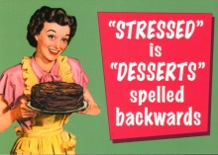

Slide 39
Alternative methods
Muscle relaxation and meditation
Jacobson tensed and relaxed method. Studies have shown (Murphy) they are effective stress management technique.
Physical exercise (think fight or flight).
Throne et al found that it reduced stress in firefighters
Social Support (network) Includes support at work.
Glaser et al found that it reduces blood pressure

